Slide 1
Predicting drug target interactions using meta-path-based semantic network analysis
Gang Fu, Ying Ding, Abhik Seal, Bin Chen, Yizhou Sun and Evan Bolton
BMC Bioinformatics
2016

Slide 2
Background
Chemo genomics and chemical systems biology aim to accelerate drug discovery through in silico predictions..
Combined chemical and biological network
1. Hypothesizing new indications for approved drugs with desired safety.
2. Proposing Combination therapy design.
3. Interpreting clinical side effects by revealing modes of drug actions.
Semantic standards and technologies facilitate data integration across multiple domains.
Several semantically linked datasets have been published to promote data mining in DR
ex) PubChemRDF, Chem2Bio2RDF, Bio2RDF, Open PHACTS etc.
A statistical model, SLAP, has been applied to Chem2Bio2RDF to predict direct links between compounds and proteins based on their indirect links or path.
SLAP is a novel and validated approach to predict DTIs(Drug-Target Interactions) outperformed existing alternatives.

Slide 3
Background
However, Predicting DTI is equivalent to link prediction, which is a fundamental problem and long-standing challenge in complex network analysis.
In drug-discovery, biological networks can be leveraged to identify potential associations between compounds and protein target.
Typical network-based DTI predictions, SLAP
1. based on similarity profiles calculated from common neighbors or direct connections
2. limited to bipartite networks.
3. But, only for homogeneous, not heterogeneous type and relations.
Therefore, for link prediction, incorporated meta-path topological features.

Slide 4
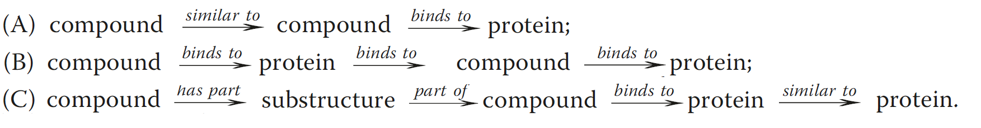
A meta-path
A meta-path defines a certain type of paths linking the starting and ending objects.
Path Count : The total number of paths belonging to a specific meta-path is an important topological feature to evaluate the strength of associations.

Slide 5
Overview
Meta-path approach provides an alternative DTI approach to SLAP
Rather than using a statistical model to study the significance of meta-path topological features, we propose a framework to take advantage of machine learning algorithms.
ex) Random Forest, SVM
A more complete drug-target connectivity map can be constructed using the predicted links.
Feature importance can be calculated at the same time as the classification models are built.
SLAP only consider path counts, but this approach can apply different kinds of normalization processes to pc.
Ex) random walk, normalized path count, and symmetric random walk
In order to compare this approach with SLAP, we have carried out link prediction experiment on Chem2Bio2RDF..
This approach can be generalized as a framework to leverage machine learning algorithms to study the topological features of the heterogeneous network for link prediction.

Slide 6
Semantic network
In the Chem2Bio2RDF semantic network, there are 9 semantic types, 10 semantic links and 2 more similarity.
9 sematic types
Compounds
Proteins
adverse side effects
Gene Ontology (GO)annotations
ChEBI types
Substructures
Tissues
biological pathways
diseases
10 different semantic links
from compounds to ChEBI types
from compounds to proteins
from compounds to substructures
from adverse side effects to compounds
from diseases to compounds
from proteins to proteins
from proteins to GO annotations
from diseases to proteins
from pathways to proteins
from tissues to proteins.
+ two more semantic links from PubChem :
compound neighboring links based on 2D structural similarity,
protein neighboring links, based on sequence similarity.
Notes:
Chemical Entities of Biological Interest (ChEBI) is a freely available dictionary of molecular entities focused on 'small' chemical compounds.

Slide 7
Semantic network
In the Chem2Bio2RDF semantic network, there are 9 semantic types, 10 semantic links and 2 more similarity.
A total of twelve adjacency matrixes were computed based on the semantic links between any two objects.
Ex) from compounds to proteins
The elements of the adjacency matrixes have to values.
0 : link is unobserved.
1 : link is observed.

Slide 8
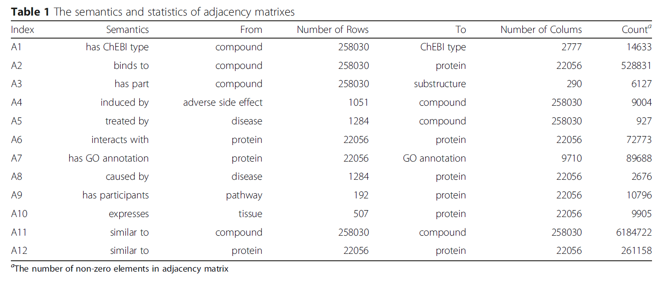
Semantic network

Slide 9
Meta-path-based topological features
The meta-path topological features were encoded in commuting matrixes, calculated by multiplying several adjacency matrixes.
The length of the meta paths equals the number of multiplied adjacency matrixes.
4 meta-paths are of length 2
11 meta-paths are of length 3
36 meta-paths are of length 4
Excepted greater than length 4.
The elements in the commuting matrix indicate the number of path instances linking compounds to proteins.
No negative integer values.
All calculation performed by Armadillo C++ linear algebra library, and matrixes were encoded as sparse for reducing memory consumption.

Slide 10
Meta-path-based topological features
Two measures of topological features were calculated.
There are 51 meta-paths.
Path Count ( PC )
The number of path instances between nodes I and j, which corresponds to the value of element in the commuting matrix.
Random Walk ( RW )
Based on the overall connectivity of the network.
As a normalization process to the number of path instances.
Calculated PCij / PCi •, where PCi,• are row-wise summations.

Slide 11
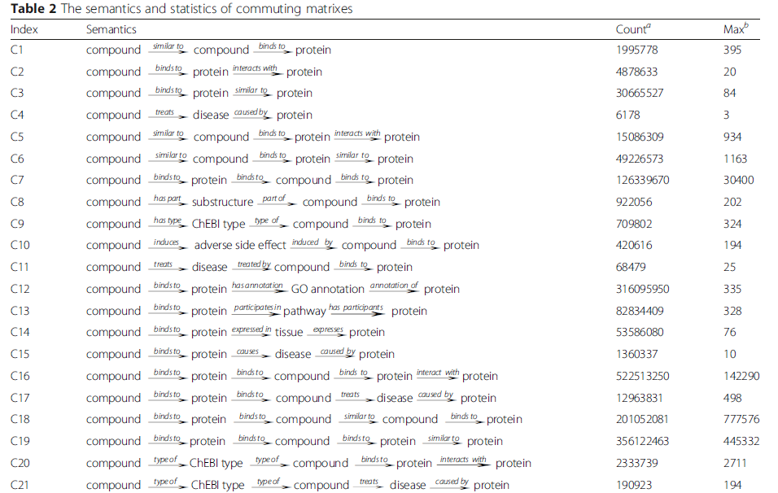
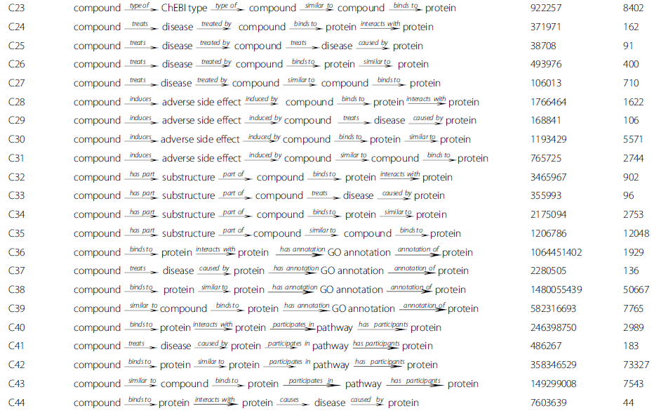
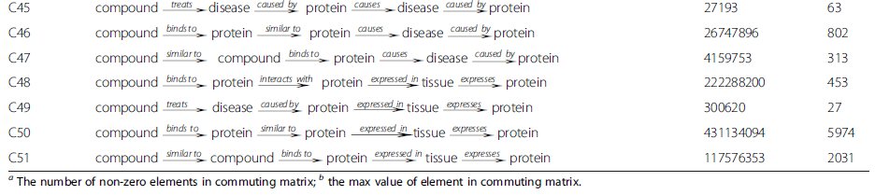

Slide 12
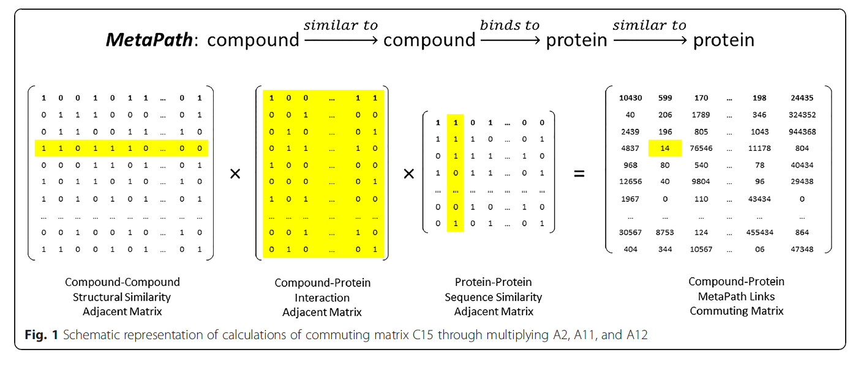
Meta-path-based topological features
The meta-path topological features were encoded in commuting matrixes, calculated by multiplying several adjacency matrixes.

Slide 13
Machine learning dataset
In order to build supervised learning models, both positive and negative labels are required.
Positive label: observed link
A total of 5,387 positively labeled links from Drugbank
Negative label: unobserved and experimental bioactivity value of pairs is greater than 10 μm, using PubChem BioAssay DB.
Accordingly, Obtained 26,682 negative labels out of over 5.6 billion unobserved links in the Chem2Bio2RDF semantic network.
The positively and negatively labeled links were combined and randomly split into training set and test set by a ratio of 2 : 1
In the training set, 3,591 positively, and 17,788 negatively labeled links.
In the test set, 1,796 positively, and 8,894 negatively labeled links.

Slide 14
Machine learning dataset
In order to further examine the ability of the proposed framework, a mush larger set of DTIs were collected from the PubChem BioAssay database.
PubChem BioAssay categorizes depositor-provided bioactivites between compounds and protein targets into active, inactive, and unspecified groups, adding to assay descriptions and activity values.
Positive label : classified as active, activity values of less than 1μm
Negative label : classified as inactive, activities for the interactions exist.
Previous links from Chem2Bio2RDF constitute a training set.
This links from PubChemBioAssay database constitute a test set.

Slide 15
Binary classification models
To demonstrate how well the similarity neighboring links obtained from PubChem databases can improve link prediction performance, we have constructed different machine learning models, based on three sets of path count topological features.
Feature Ⅰ :
29 path count topological features, not included any meta-paths involving similarity neighboring links
Feature Ⅱ :
All of path counts
Feature Ⅲ :
Path count + Random walk ( 102 )

Slide 16
Binary classification models
Random Forest ( RF )
A collection of decision trees from bootstrap samples of the training data without pruning.
Make predictions based on majority votes of the ensemble trees.
Takes advantage of Out-of-Bag error
So, there is no need to run cross-validation
RF can calculate the importance of features as well.
Either classification accuracies or node impurities are measured before and after permutations.
The difference in the measures is used to evaluate feature importance.

Slide 17
Binary classification models
Support Vector Machine ( SVM )
Support Vector Machine is based on a statistical learning theory.
A soft margin SVM with radial basis function (RBF) kernel in the Gaussian form was used in this study.
The optimal values for tuning parameters ( C and λ ) were determined by a grid search using 10-fold across-validation
The C tells the SVM optimization how much you want to avoid misclassifying training example

Slide 18

Binary classification models
F1-score can be used for statistical hypothesis testing for imbalanced datasets.
F1-score is the harmonic mean of precision and recall

Slide 19
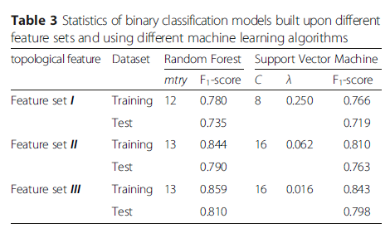
Binary classification models

Slide 20
Binary classification models
Both RF and SVM can calculate the probabilities of classifications, and rankings can be derived from the probability calculations.
The predictive performance on rankings was evaluated by AUCROC, AUCPR
AUCROC, AUCPR are in R package ‘Miscellaneous Esoteric Statistical Scripts’

Slide 21
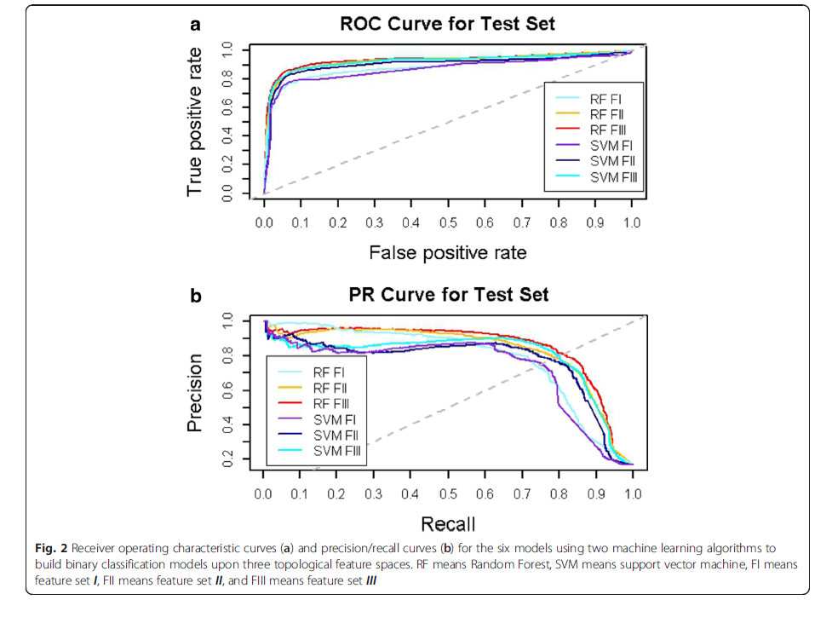
Binary classification models

